Slide 1



C ODERCUBE
PROBLEM STATEMENT ID: 4

Slide 2
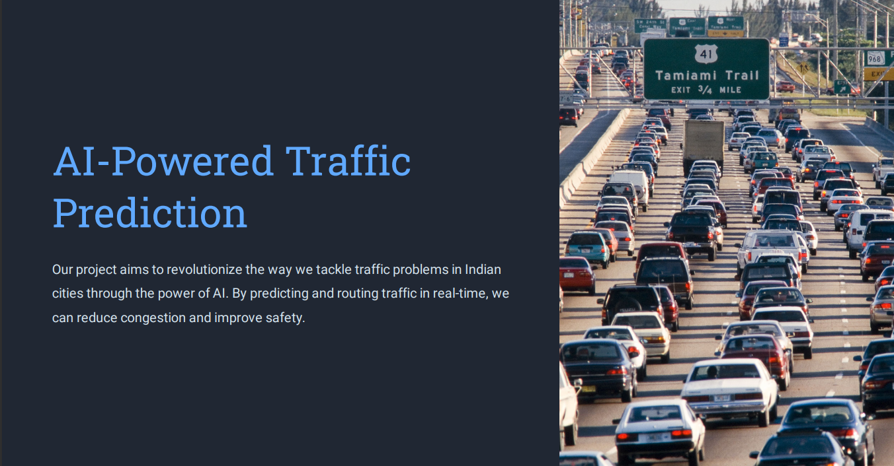

Slide 3
TrafficMaster : An AI-Powered Traffic Prediction and Optimization ML Model for Smarter Commutes :
Developing an AI-based traffic prediction and routing system that takes into account real-time traffic data, weather, road conditions, and other factors to optimize traffic flow and reduce travel time.

Slide 4


SOLUTION

Slide 5





Slide 6
HOW IS YOUR SOLUTION DIFFERENT FROM EXISTING SOLUTION
LIST DOWN AT LEAST 3 DIFFERENECES

Slide 8
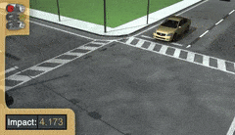

Slide 9






TECH STACK USED :
WHAT ALL TECHNOLOGIES YOU HAVE USED TO BUILD THE SOLUTION
YOLO
Kaggle
Kaggle
Python
TensorFlow
GITHUB

Slide 10






TECH STACK USED :
WHAT ALL TECHNOLOGIES YOU HAVE USED TO BUILD THE SOLUTION
Python
Kaggle
Keras
Yolo
TensorFlow
Github

Slide 11




TEAM MEMBERS:

